Slide 1

Data Analysis of IT tickets & Recommendations
Joshua Aptroot, Web & Digital, 03/03/2025

Slide 2
Executive Summary
Process: The project analysed data, looking for patterns and trends that could indicate problems or opportunities within current processes.
Hypothesis & objectives: Average ticket resolution time & sum of ticket resolution time are influenced by other variables within the dataset of IT ticket data.
Key Findings: There are notable relationships between the sum or average of resolution time and other characteristics of tickets…
Recommendations: Continuous improvement, Automation, prevention.

Slide 3

The organisational challenge
The pursuit of digital transformation, improvements in operational efficiency and simplification of IT delivery
The ability to capture, respond to, and deliver on requirements is influenced directly by the ability to connect with stakeholders.
To remain grounded in a reasonable scope, the analysis focuses solely on web and digital tickets

Slide 4





Data sources & Methodology
All data has been extracted from ServiceNow, the platform LBR uses to track and monitor ticket management (csv).
Data Cleaning for EDA
EDA (Exploratory data analysis)
Data cleaning for advanced analysis
Advanced analysis (Linear regression)
Advanced analysis (Random forest regression)
Advanced analysis (K-means clustering)
Develop Recommendations
Find the Important tickets!
(tickets that are either so common they are taking up all our time, or tickets that are so hard they are taking up all our time)

Slide 5
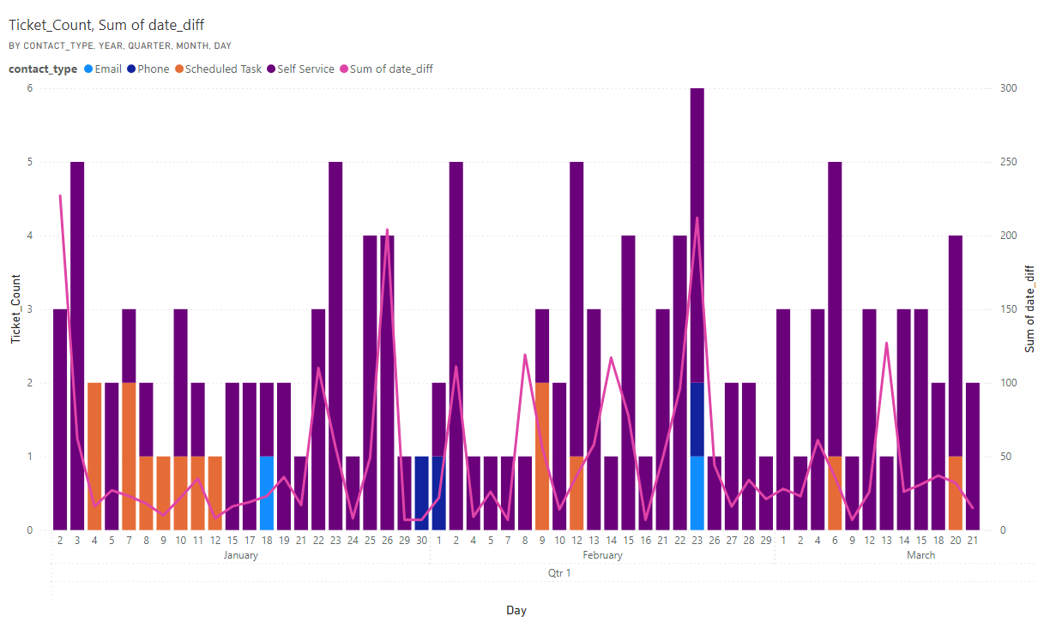
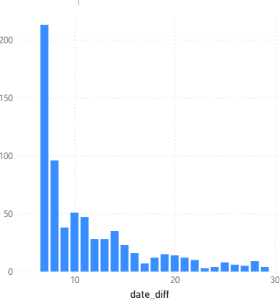
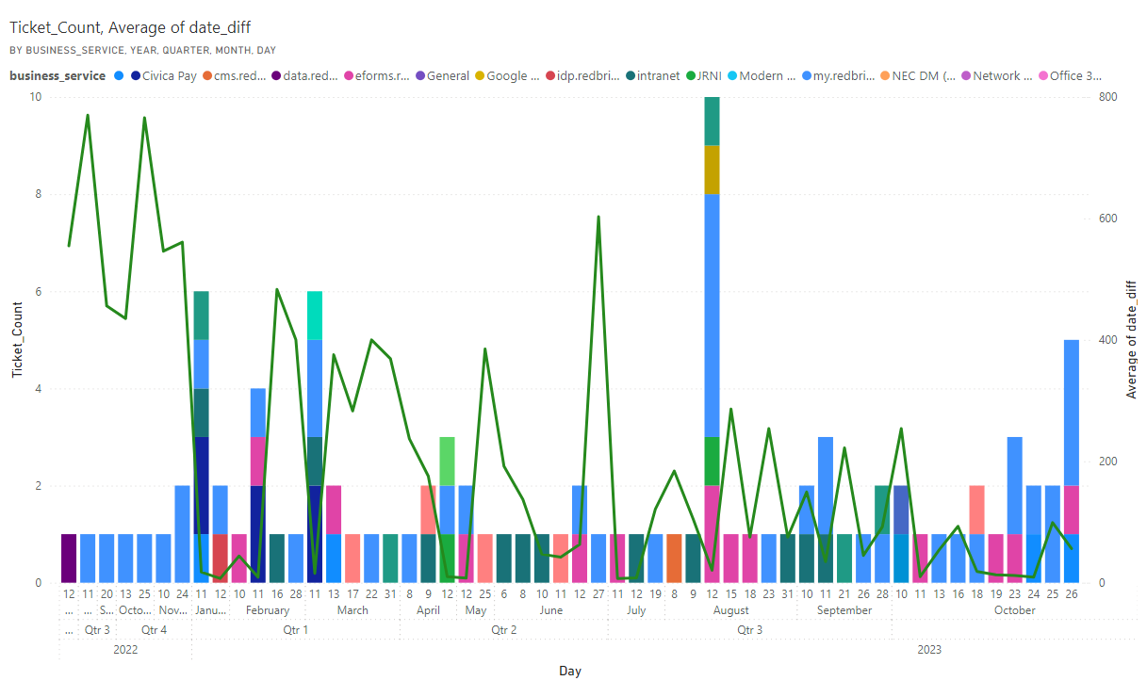
Exploratory analysis: Resolution time (Average)
Sum of resolution time vs ticket count (Legend source)
Takeaway:
Average is not visibly tied to any characteristic
The sum is connected to how many tickets are submitted?
Resolution time vs ticket count
Average of resolution time vs ticket count (Legend type)
Question:
What is the Sum of tickets made up of

Slide 6
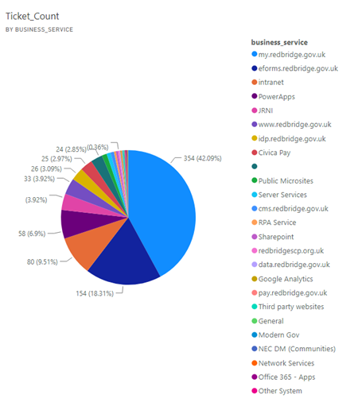
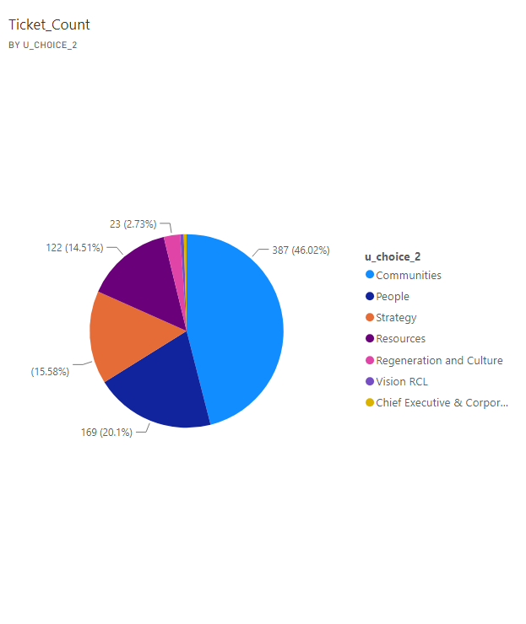
Exploratory analysis: Resolution time (Sum)
Tickets by type:
Tickets by source:
Takeaway:
There is a clear source and type of tickets.
Question:
Are these two fields interconnected?

Slide 7
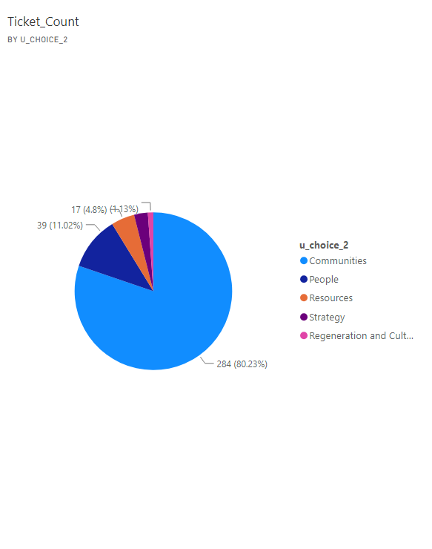
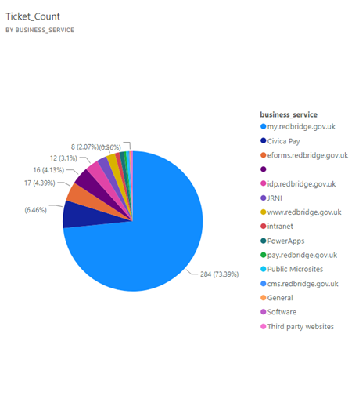
Exploratory analysis: Resolution time (Sum)
Takeaway:
Communities and my.rebridge tickets are interrelated, and make up the Sum of resolution time and this is an are of significant impact to web and digital.
Communities' tickets by type
My.Redbridge tickets by source
Question:
Will advanced analysis reveal relationships between average resolution time and other characterisitcs

Slide 8
Linear and non-linear regression
Multiple - Linear regression makes predictions about the average resolution time and ticket characteristics, based on linear relationships between tickets (Qualtrics, (n.d.) )
Non-linear regression does not assume a linear relationship between the variables. Instead, it allows for more flexible, complex relationships. The relationship between the dependent (average resolution time) and independent variables (characteristics) can take many forms, such as quadratic, exponential, logarithmic, or other types of non-linear functions. (Qualtrics, (n.d.))

Slide 9
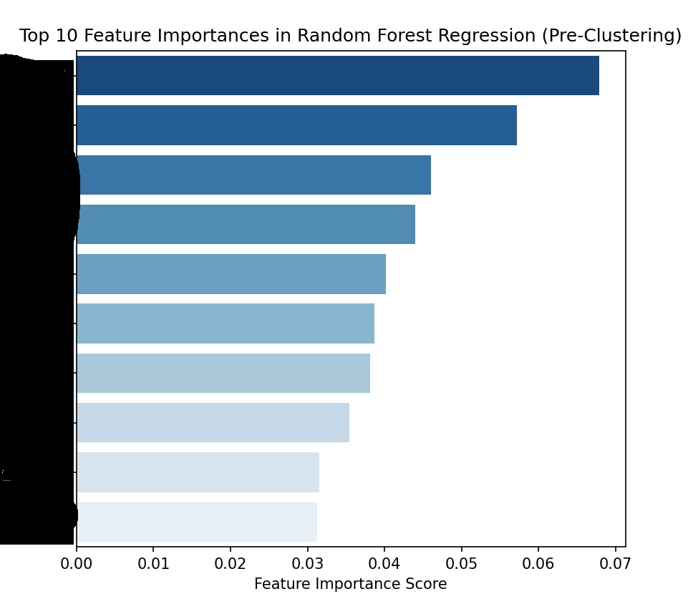
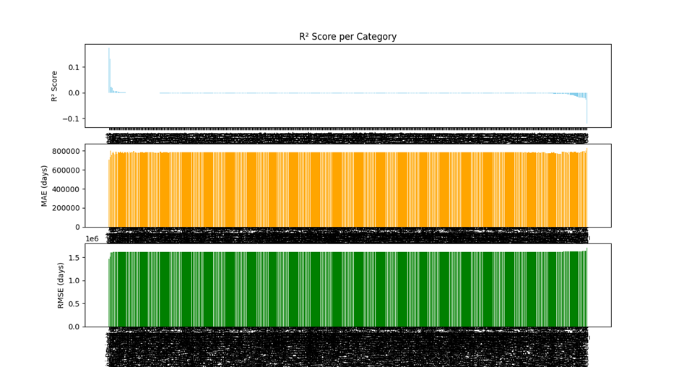
Advanced Analysis: (regression)
Feature importance: 0.07
Non-Linear
TOO LOW!
R-squared: steady with no value above 0.2
R²
Linear
MAE: large values indicating a large difference between predicted and actual values
MAE
RMSE: large values indicating a large difference between predicted and actual values
RMSE

Slide 10
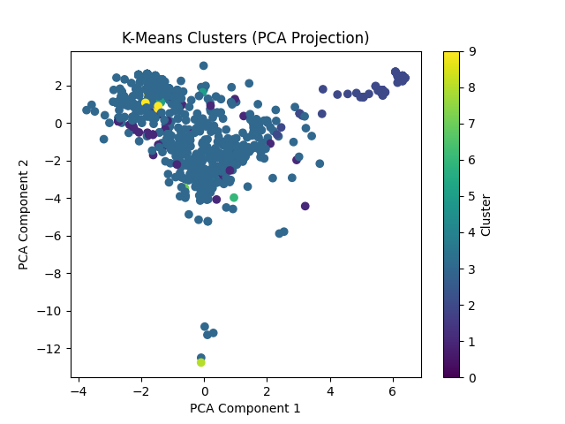
Advanced Analysis: K-means clustering

Slide 11
The Important “cluster”
Low Priority
Communities tickets
Self-service tickets
my.redbridge tickets

Slide 12

Recommendations
Continuous Analysis: Iterative predictive analytics, ongoing data analysis should be conducted to refine insights, validate recommendations, and adapt to new data, ensuring continuous improvement in resolution time.
Automation and AI: Implement automated and AI-assisted responses for low-priority tickets, particularly for recurring “my.redbridge” issues, to reduce manual effort and speed up resolutions.
Preventative and Investigative Measures: Review the communities’ ticket handling system to identify recurring issues, allocate resources effectively, and address recurring issues impacting resolution times.

Slide 13

Any Questions?

Slide 14
References & Bibliography
Kohtamäki, M. (2017) Real-time Strategy and Business Intelligence. [edition unavailable]. Palgrave Macmillan. Available at: https://www.perlego.com/book/3497628(opens in a new tab) (Accessed: February 20th 2025).
GeeksforGeeks (n.d.) Types of Analytics. Available at: https://www.geeksforgeeks.org/types-of-analytics/ (Accessed: 1 March 2025).
Qualtrics (n.d.) Regression Analysis: The Ultimate Guide. Available at: https://www.qualtrics.com/uk/experience-management/research/regression-analysis (Accessed: 27th February 2025).
Harvard Business School Online (2023) What Is Regression Analysis in Business Analytics?. Available at: https://online.hbs.edu/blog/post/what-is-regression-analysis (Accessed: 28th February 2025).
Github: Stu-joshua-aptroot/Kmeans_Clustering_for_cleaning: a single program run over structured CSV for NLP processing and cleaning.

